Slide 1
Test Drive Labs An Introduction to Open Telemetry with F5 BIG-IP and NGINX Plus
F5 Business Development
Tuesday, September 30, 2025

Slide 2


Our Team
Greg Coward
Sr Solutions Architect
Joe Kanagusuku
Sr Technical Alliance Manager

Slide 3

Book A Meeting With Us! A Test Drive Lab exclusive offer…
BOOK AND COMPLETE A MEETING
JBL Speaker
Book a meeting with our Connections Agent,
Zach Wolfe at
z.wolfe@f5.com
And complete the meeting with the F5 Account team to receive an F5 limited-edition JBL speaker!

Slide 4
Logging in to the course
You would have received an email instructing you to create an account on F5 Unified Demo Framework
As per the email you received yesterday – you need an account to log into the F5 Unified Demo Framework (including 2FA)
Did you create an account prior to today’s course?
If so – Great work!!!!
If not – Please follow the instructions in that email now

Slide 5
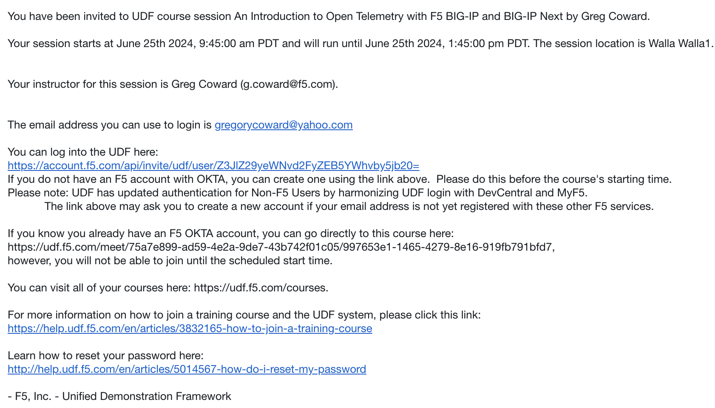
Logging into the course
Click on this link to log in and join the course

Slide 6
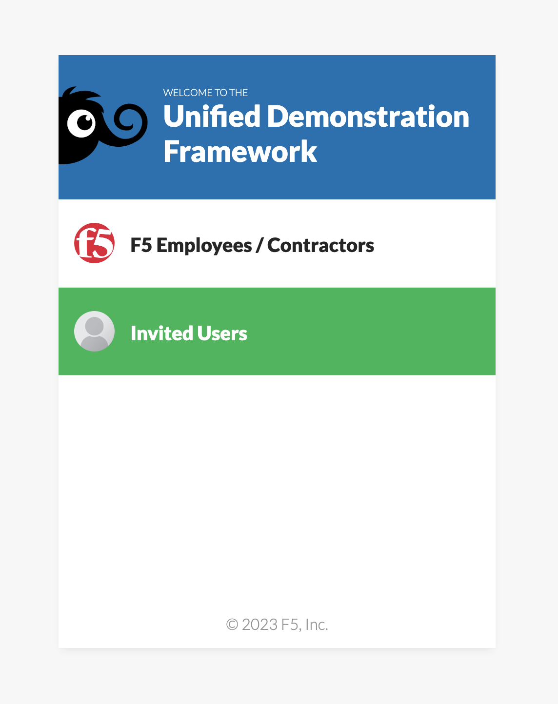
Logging in to the course
Click “Invited Users”

Slide 7
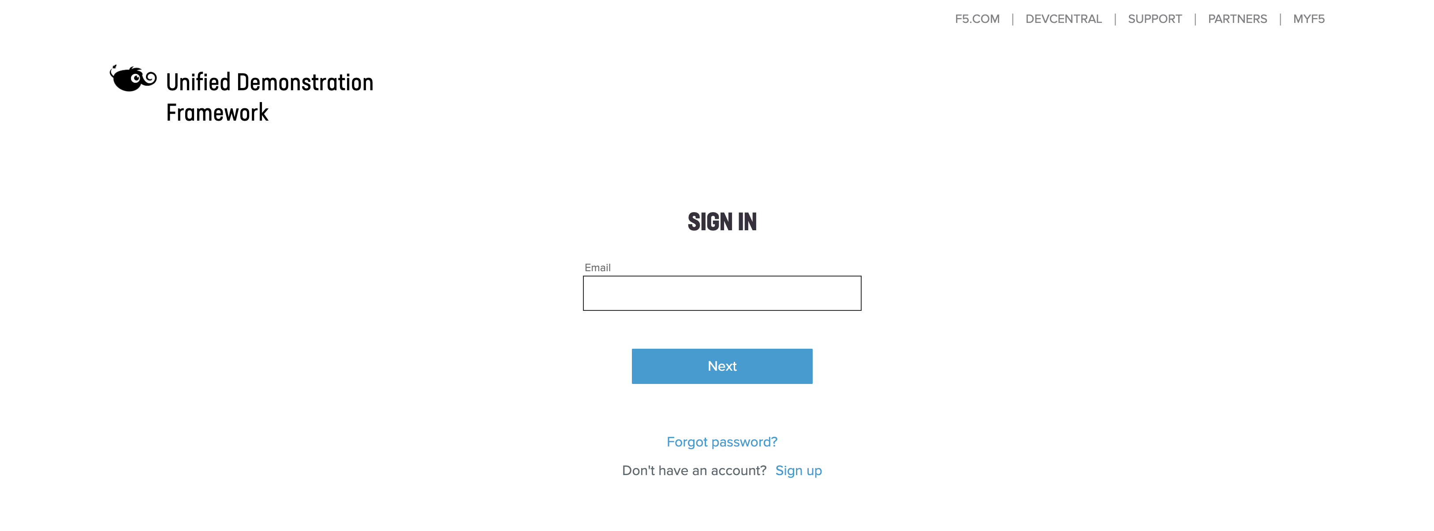
Logging in to the course
Log in with the credentials you set up yesterday

Slide 8
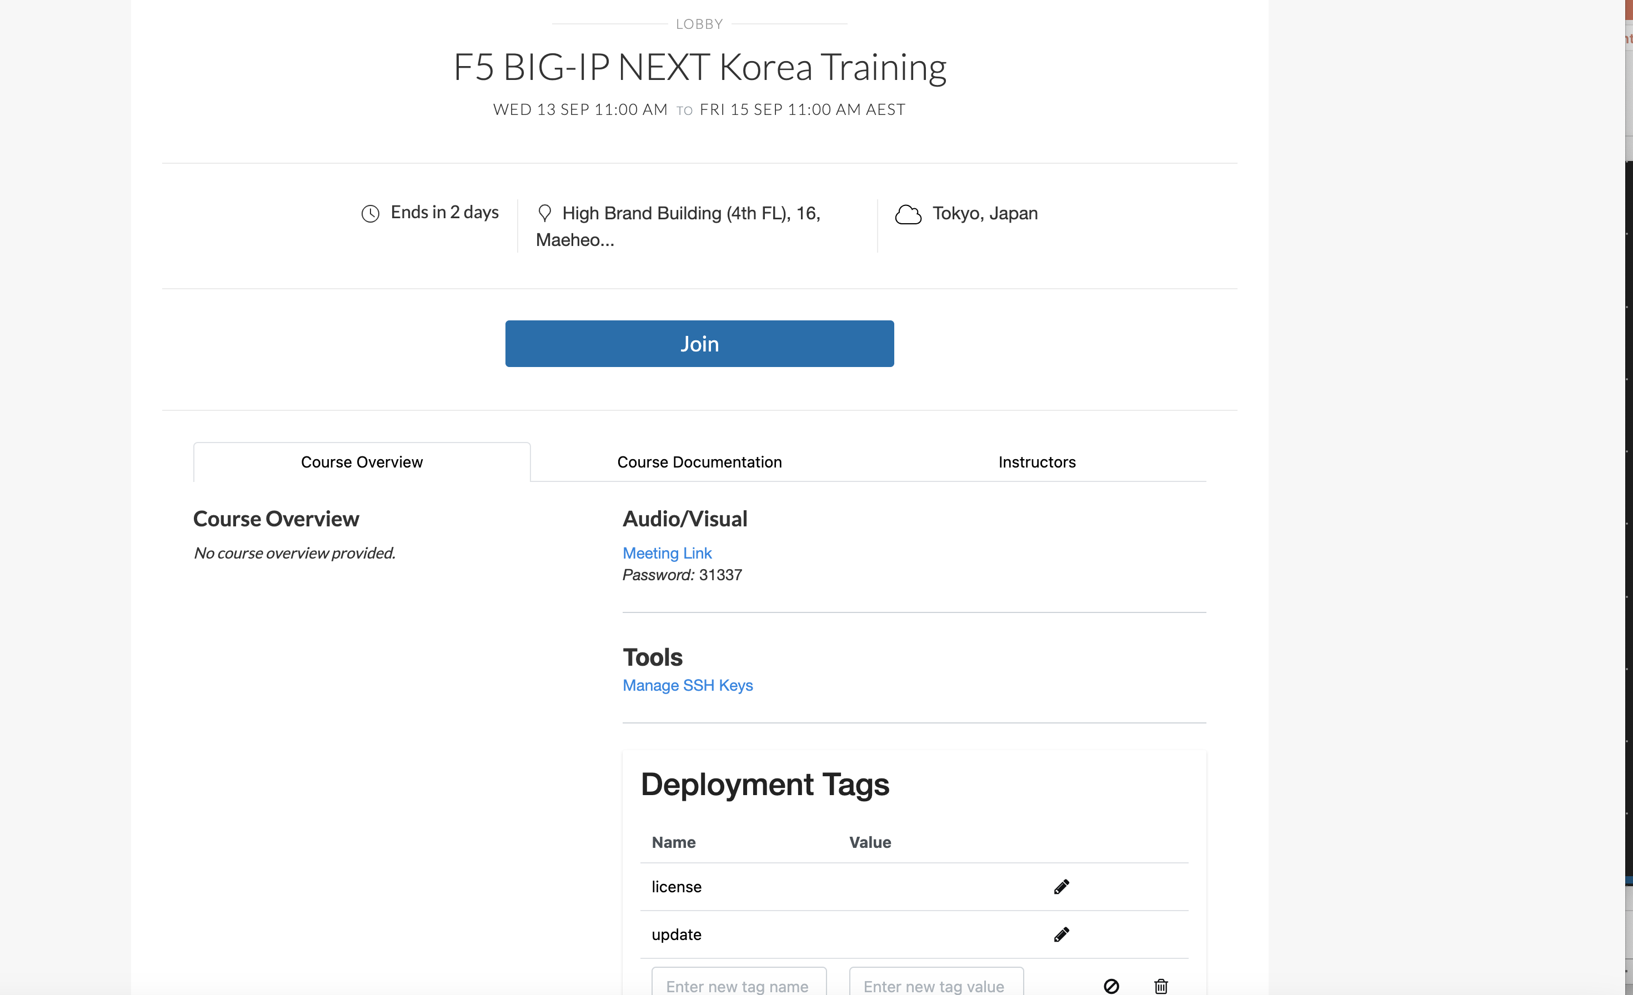
Logging in to the course
Join the session
Click on this link to log in and join the session

Slide 9
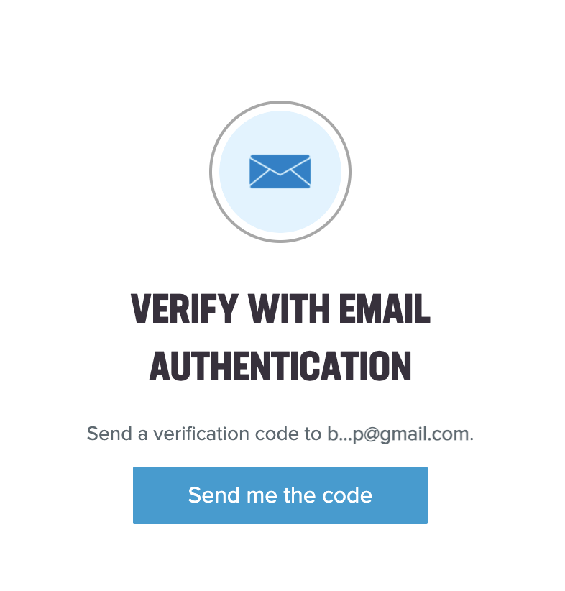
Logging in to the course
Verify with 2FA you set up when you created your account

Slide 10
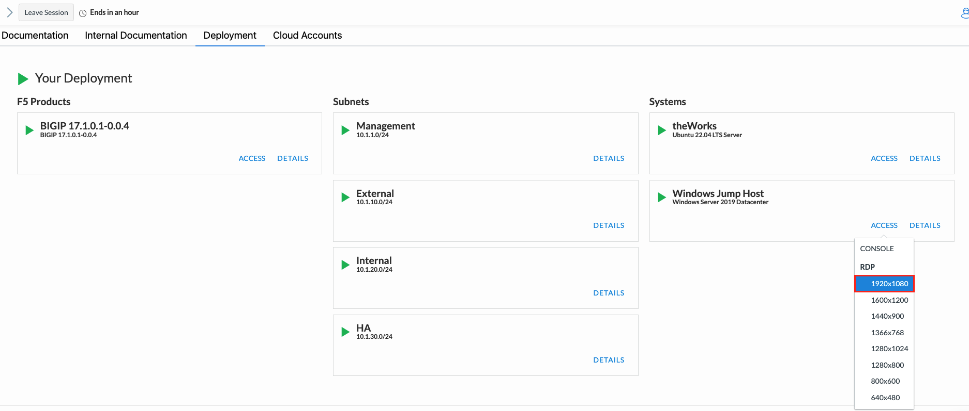
Logging in to the course
Verify your deployments are starting

Slide 11

Agenda
Open Telemetry Primer
Lab1 – App instrumentation walk-through and troubleshooting
Lab2 – Exporting NGINX Plus traces and metrics using Open Telemetry
Lab3 – Exporting BIG-IP metrics using the Open Telemetry TS consumer
Q & A

Slide 12
The Three Pillars of Observability
Traces
Definition: Tracks the journey of a request as it flows through different services and components.
Purpose: Helps in identifying performance bottlenecks, failures, and understanding the flow of transactions.
Key Aspects:
Span: A single operation within a trace.
Trace: A collection of spans showing the path of a request.
Context Propagation: Ensures trace data is carried across service boundaries.
Metrics
Definition: Numeric data representing the performance and health of systems over time.
Purpose: Provides quantitative measures for monitoring and alerting on system health and performance.
Key Aspects:
Counters: Increment-only values (e.g., request count).
Gauges: Values that can go up and down (e.g., CPU usage).
Histograms/Summaries: Distributions of values (e.g., response times).
Logs
Definition: Timestamped records of discrete events that occurred within a system.
Purpose: Offers detailed context and insights into the state and behavior of applications.
Key Aspects:
Structured vs. Unstructured: Logs can be formatted for easy parsing or free-form text.
Log Levels: Severity indicators (e.g., DEBUG, INFO, WARN, ERROR).
Correlation: Linking logs with traces for comprehensive analysis.

Slide 13
What is Open Telemetry
OpenTelemetry (OTel) is an open-source observability framework for cloud-native software, which enables developers to collect, process, and export telemetry data (metrics, logs, and traces) to monitor and understand software performance and behavior.
Unified Standard: Provides a single set of APIs, libraries, agents, and instrumentation for capturing telemetry data.
Vendor-Neutral: Works with various backends and tools, avoiding vendor lock-in.
Comprehensive Monitoring: Helps in diagnosing issues, optimizing performance, and ensuring reliable operations of distributed systems.
Open Telemetry is not….
Not a Monitoring Tool: It doesn't directly monitor your applications; it collects and exports telemetry data for use with other monitoring tools.
Not a Storage System: It doesn't store telemetry data. You'll need a backend like Prometheus, Jaeger, or a commercial observability platform for storage and analysis.
Not a Visualization Tool: It doesn't provide dashboards or visualizations. Use tools like Grafana or Kibana for visualizing the collected data.
Not a Compete Solution: It’s a part of the observability stack, not a standalone solution.

Slide 14
OTel Components
The Specification
Sets cross-language standards and expectations for all implementations. This ensures consistency and interoperability across different systems and languages in the observability stack.
API
Defines data types and operations.
For generating and correlating tracing, metrics, and logging data.
Data
Defines the OpenTelemetry Protocol (OTLP).
Establishes vendor-agnostic semantic conventions for telemetry backends
SDK
Outlines requirements for language-specific API implementation.
Includes configuration, data processing, and exporting.
Language-specific API & SDK implementations
OpenTelemetry also has language SDKs that let you use the OpenTelemetry API to generate telemetry data with your language of choice and export that data to a preferred backend. These SDKs also let you incorporate instrumentation libraries for common libraries and frameworks that you can use to connect to manual instrumentation in your application.

Slide 15
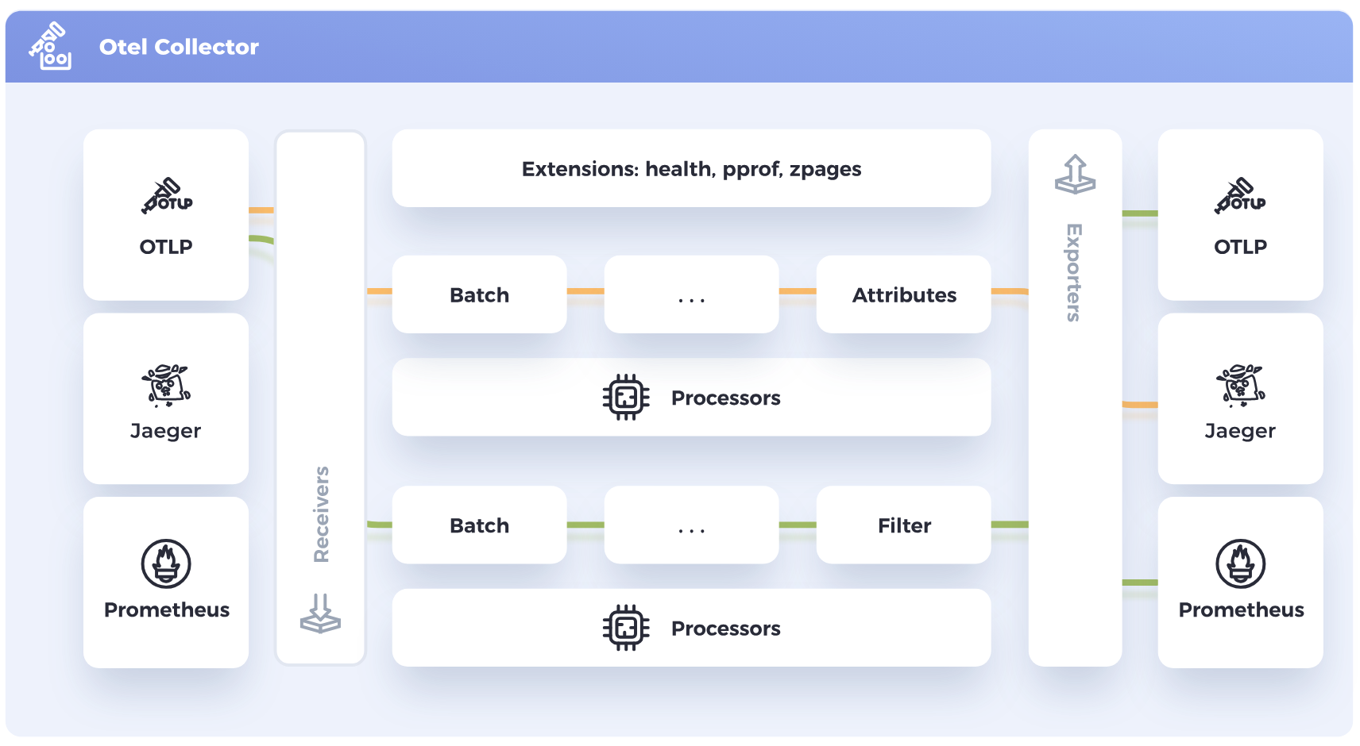
OTel Components
Collector
The OpenTelemetry Collector is a vendor-agnostic proxy designed to receive, process, and export telemetry data. It supports receiving data in multiple formats, including OTLP, Jaeger, Prometheus, and many commercial/proprietary tools.
The Collector can send this data to one or more backends for storage and analysis. It also has the capability to process and filter telemetry data before exporting it, allowing for efficient data management and customization based on specific needs.

Slide 16
OTel Components
Kubernetes Operator
The OpenTelemetry Operator is an implementation of a Kubernetes Operator. The operator manages the OpenTelemetry Collector and auto-instrumentation of the workloads using OpenTelemetry.
Function as a Service assets
OpenTelemetry supports various methods of monitoring Function-as-a-Service provided by different cloud vendors. The OpenTelemetry community currently provides pre-built Lambda layers able to auto-instrument your application as well as the option of standalone Collector Lambda layer that can be used when instrumenting applications manually or automatically.

Slide 17
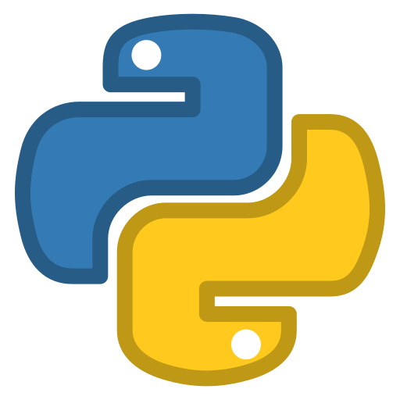
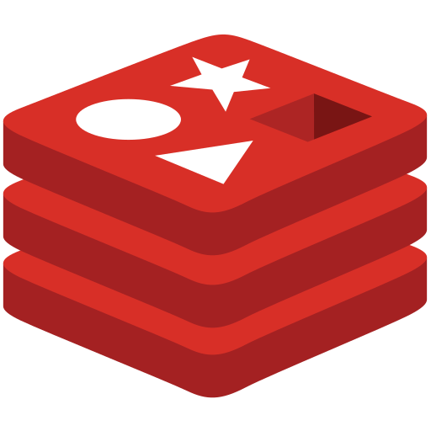


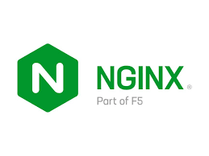


The Open Telemetry Lab
Sample Application
Python App
Traces
Observability
Direct delivery via OTLP
Redis database
Jaeger
Traces
Collector Gateway
Prometheus
Metrics
Traces
via OTLP
Metrics
BIG-IP
Virtual Edition
Metrics
via OTLP

Slide 18
Helpful Links
Open Telemetry (OTel) resources
Open Telemetry Documentation - https://opentelemetry.io/docs/
OTEL Collector - https://opentelemetry.io/docs/collector/
Collector Contrib GitHub Repo - https://github.com/open-telemetry/opentelemetry-collector-contrib
Troubleshooting - https://clouddocs.f5.com/products/extensions/f5-telemetry-streaming/latest/troubleshooting.html
Related F5 resources
F5 Telemetry Streaming - https://clouddocs.f5.com/products/extensions/f5-telemetry-streaming/latest/
F5 Application Services 3 Extension - https://clouddocs.f5.com/products/extensions/f5-appsvcs-extension/latest/
NGINX Open Telemetry Module – https://docs.nginx.com/nginx/admin-guide/dynamic-modules/opentelemetry/

Slide 19


Session Survey
Survey Link

